Slide 1
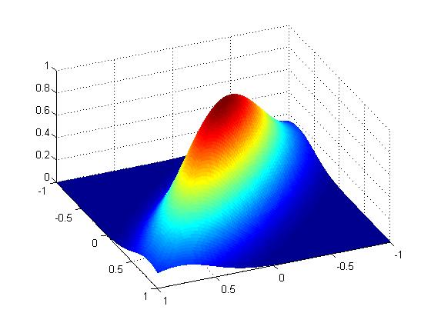
Polynomial Accelerated Iterative Sampling of Normal Distributions
Al Parker
July 19, 2011

Slide 2
Acknowledgements
Colin Fox, Physics,
University of Otago
New Zealand Institute of Mathematics,
University of Auckland
Center for Biofilm Engineering, , Bozeman

Slide 3
The multivariate Gaussian distribution

Slide 4
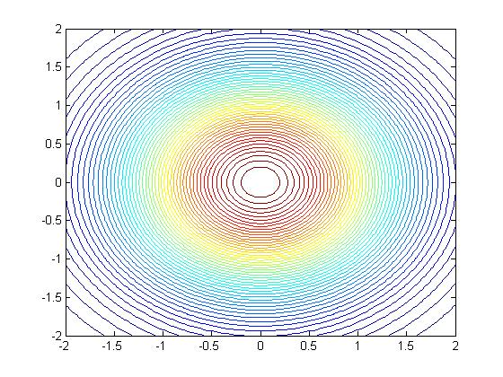
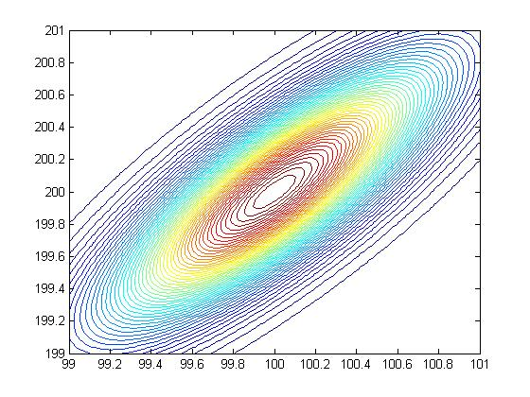
How to sample from a Gaussian N(µ,Σ)?
Sample z ~ N(0,I)
y = Σ^{1/2} z+ µ
~ N(µ,Σ)
Notes:
Z=[.9501 .2311]’ ~ N(0,I), x=[100.39 200.12]’ ~ N([100,200]’,[11 -9;-9 11]^(-1))

Slide 5
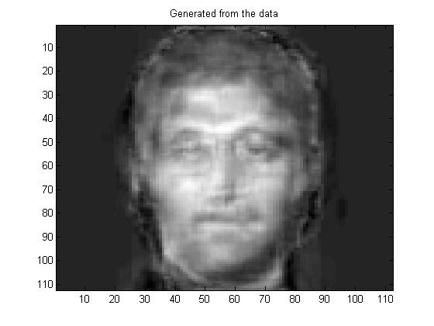
The problem
To generate a sample y = Σ^{1/2} z+ µ ~ N(µ,Σ),
how to calculate the factorization Σ =Σ^{1/2}(Σ^{1/2})^{T} ?
Σ^{1/2} = WΛ^{1/2} by eigen-decomposition, 10/3n³ flops
Σ^{1/2} = C by Cholesky factorization, 1/3n³ flops
For LARGE Gaussians (n>10⁵, eg in image analysis and global data sets), these factorizations are not possible
n³ is computationally TOO EXPENSIVE
storing an n x n matrix requires TOO MUCH MEMORY
Notes:
Once one has a factorization, then samples can be generated at the expense of a matrix-vector multiply, at a cost of about 2n^2 each
Cressie and Johannesson, Fixed rank krigging for very large spatial datasets, 2006

Slide 6
Some solutions
Work with sparse precision matrix Σ⁻¹ models (Rue, 2001)
Circulant embeddings (Gneiting et al, 2005)
Iterative methods:
Advantages:
COST: n² flops per iteration
MEMORY: Only vectors of size n x 1 need be stored
Disadvantages:
If the method runs for n iterations, then there is no cost savings over a direct method
Notes:
The cost of producing a sample using an iterative method requires burn-in time, and then the IACT determines the length between samples which have the same variance reducing power as a single independent sample.

Slide 7
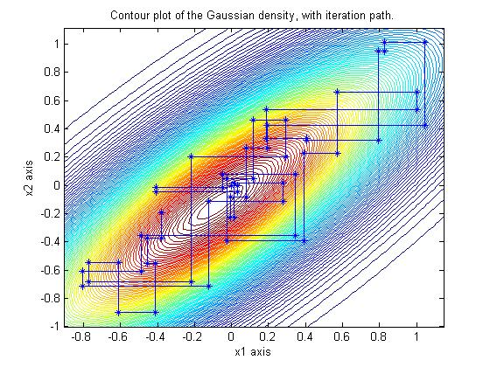
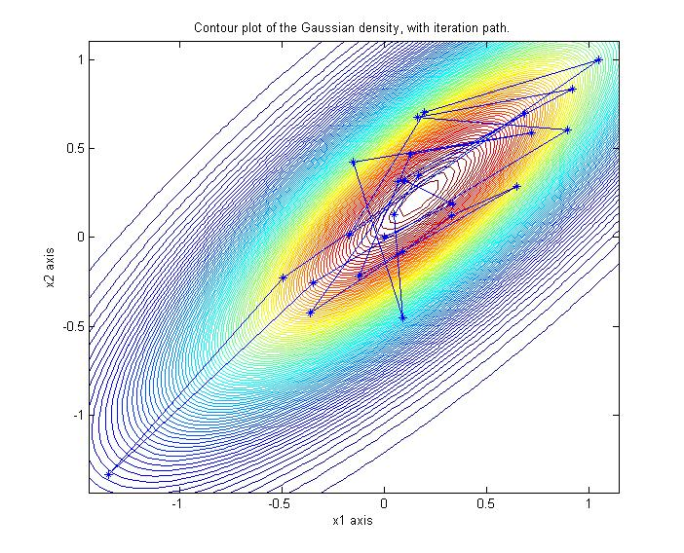
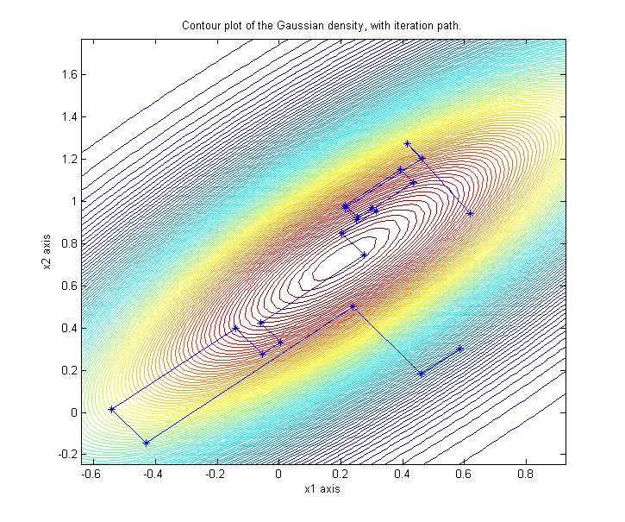
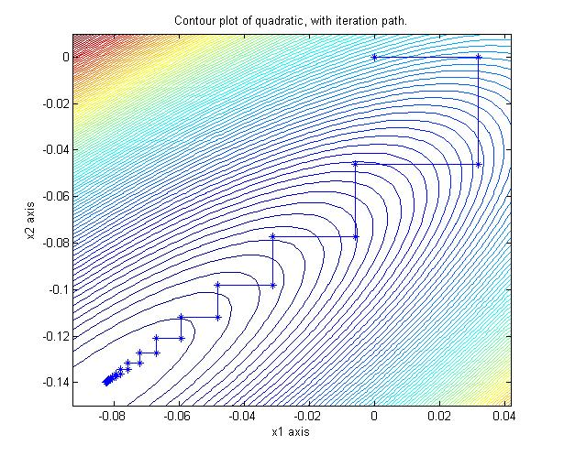
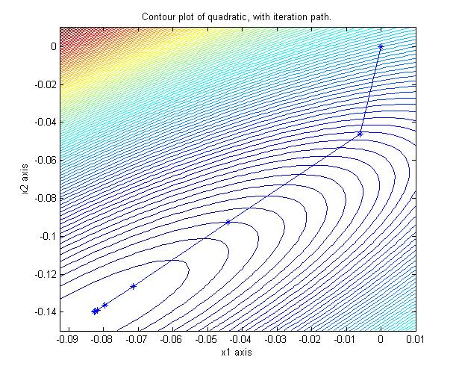
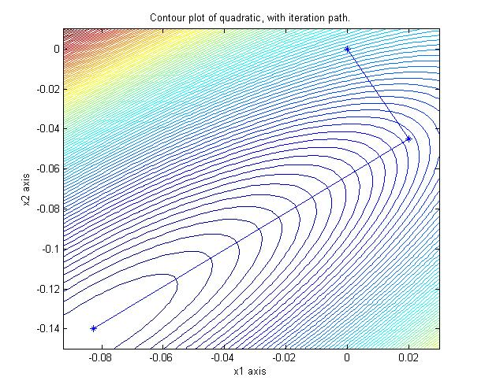
What iterative samplers are available?
Sampling y ~ N(0,A⁻¹):
Gibbs Chebyshev-Gibbs Lanczos
Solving Ax=b:
Gauss-Seidel Chebyshev-GS CG-Lanczos
Notes:
Linear solvers!

Slide 8
What’s the link to Ax=b?
Solving Ax=b is equivalent to minimizing an n-dimensional quadratic (when A is spd)
A Gaussian is sufficiently specified by the same quadratic (with A= Σ⁻¹and b=Aμ):

Slide 9
CG-Lanczos solver and sampler
CG-Lanczos estimates:
a solution to Ax=b
eigenvectors of A
in a k-dimensional Krylov space
CG sampler produces:
y ~ N(0, Σ_{y} ≈ A⁻¹)
Ay ~ N(0, AΣ_{y}A ≈ A)
with accurate covariances in the same
k-dimensional Krylov space
Schneider and Willsky, 2001
Parker and Fox, 2011
Notes:
i.e. after k iterations!

Slide 10
CG-Lanczos solver in finite precision
The CG-Lanczos search directions span a Krylov space much smaller than the full space of interest.
CG is still guaranteed to find a solution to Ax = b …
Lanczos eigensolver will only estimate a few of the eigenvectors of A …
CG sampler produces
y ~ N(0, Σ_{y} ≈ A⁻¹)
Ay ~ N(0, AΣ_{y}A ≈ A)
with accurate covariances …
… in the eigenspaces corresponding to the well separated eigenvalues of A that are contained in the
k-dimensional Krylov space
Notes:
The number of iterations k depends on the distribution of the eigenvalues of A

Slide 11
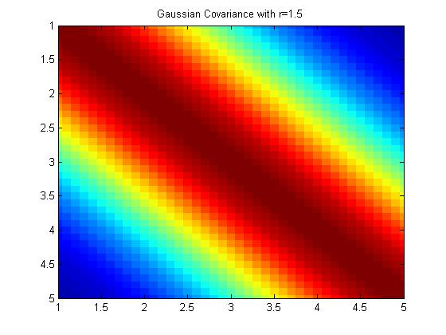
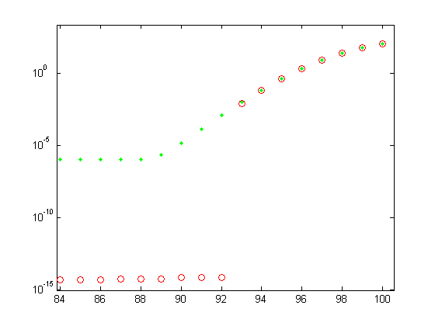
Example: N(0,A) over a 1D domain
A =
eigenvalues of A
Only 8 eigenvectors
(corresponding to the 8 largest eigenvalues)
are sampled (and estimated) by the CG sampler
covariance matrix
Notes:
norm(A) = 103.5, cond(A) = 10^8

Slide 12
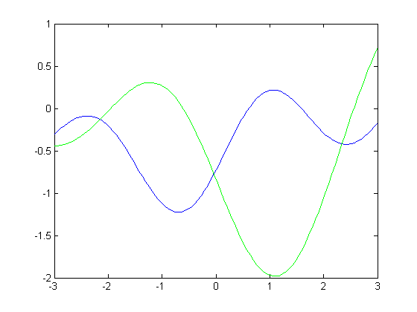
Example: N(0,A) over a 1D domain
Ay ~ N(0, A)
Cholesky sample CG sample
λ _{-(k+1)} ≤ ||A - Var(Ay^{CG})||₂ ≤ λ _{-(k+1)} + ε
Notes:
Sampling from an 8 dimensional eigenspace is good enough, corroborated by simulation studies.
The biggest eigenvalue not being estimated is 10^-4
λ _{-(k+1)} is the next eigenvalue of A not being estimated by Lanczos.
tr(Var(Ay)/tr(A) = .9965, ||A - Var(Ay)|| < 0.60, ||A - Var(Ay)|| /||A|| = 0.0058

Slide 13
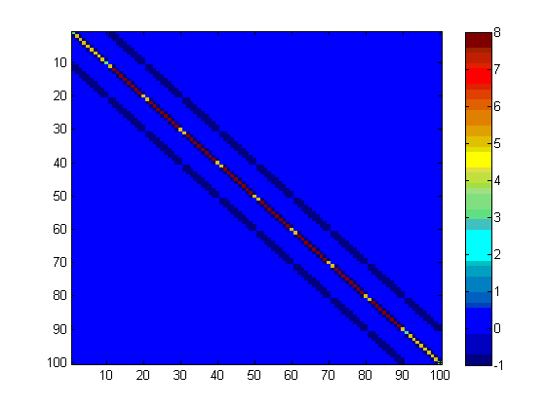
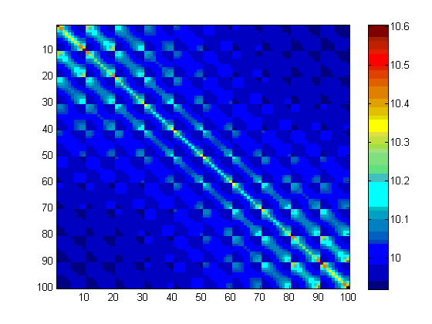
Example: 10⁴ Laplacian over a 2D domain
A(100:100) =
A⁻¹(100:100) =
precision matrix covariance matrix

Slide 14
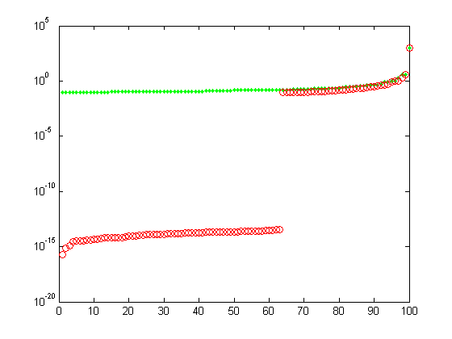
Example: 10⁴ Laplacian over a 2D domain
eigenvalues of A⁻¹
35 eigenvectors
are sampled
(and estimated)
by the CG sampler.

Slide 15
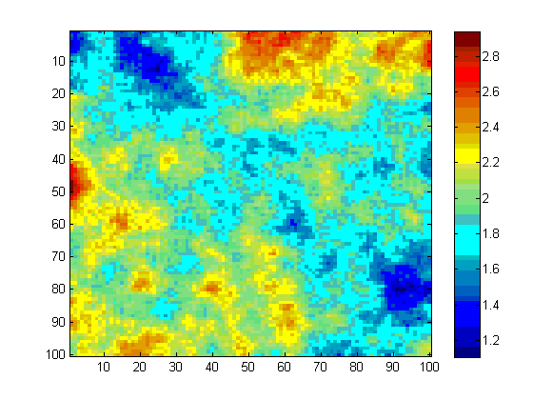
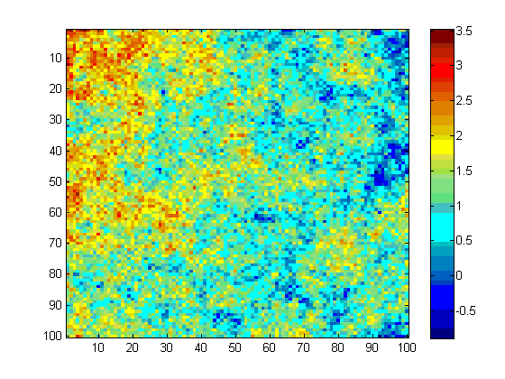
Example: 10⁴ Laplacian over a 2D domain
y ~ N(0, A⁻¹)
Cholesky sample CG sample
trace(Var(y^{CG})) / trace(A⁻¹) = 0.80
Notes:
The eigenspaces not sampled accounting for the other 20% of the variability in the data account for the lower frequencies in the samples.

Slide 16
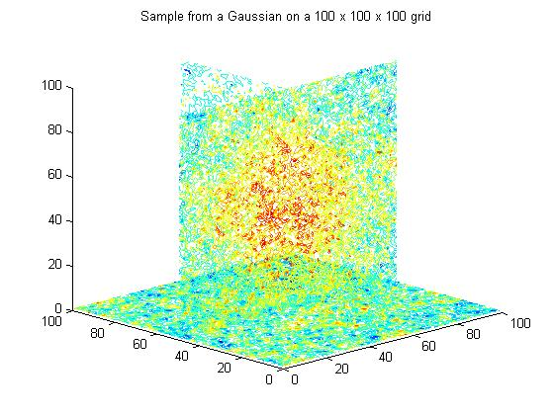
How about an iterative sampler from LARGE Gaussians that is guaranteed to converge for arbitrary covariance or precision matrices?
Could apply
re-orthogonalization
to maintain an orthogonal
Krylov basis,
but this is expensive
(Schneider and Willsky, 2001)
Notes:
This is a 10^6 with Laplacian precision sample over a 100x100x100 domain.

Slide 17
Gibbs: an iterative sampler
Gibbs sampling from N(µ,Σ) starting from (0,0)

Slide 18
Gibbs: an iterative sampler of N(0,A) and N(0, A⁻¹ )
Let A=Σ or A= Σ⁻¹
Split A into D=diag(A), L=lower(A), L^{T}=upper(A)
Sample z ~ N(0,I)
Take conditional samples in each coordinate direction, so that a full sweep of all n coordinates is
y^{k} =-D⁻¹ L y^{k} - D⁻¹ L^{T} y^{k-1} + D^{-1/2} z
y^{k} converges in distribution geometrically to N(0,A⁻¹)
E(y^{k})= G^{k} E(y⁰) Var(y^{k}) = A⁻¹ - G^{k} (A⁻¹ - Var(y⁰))G^{kT}
Ay^{k} converges in distribution geometrically to N(0,A)
Goodman and Sokal, 1989

Slide 19
Gauss-Siedel Linear Solve of Ax=b
Split A into D=diag(A), L=lower (A), L^{T}=upper(A)
Minimize the quadratic f(x) in each coordinate direction, so that a full sweep of all n coordinates is
x^{k} =-D⁻¹ L x^{k} - D⁻¹ L^{T} x^{k-1} + D⁻¹ b
x^{k} converges geometrically A⁻¹b
(x^{k} - A⁻¹b) = G^{k}( x⁰ - A⁻¹b)
where ρ(G) < 1

Slide 20
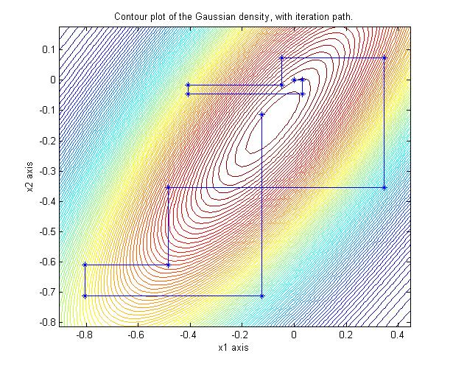
Theorem: A Gibbs sampler is a Gauss Siedel linear solver
Proof:
A Gibbs sampler is
y^{k} =-D⁻¹ L y^{k} - D⁻¹ L^{T} y^{k-1} + D^{-1/2} z
A Gauss-Siedel linear solve of Ax=b is
x^{k} =-D⁻¹ L x^{k} - D⁻¹ L^{T} x^{k-1} + D⁻¹ b
Notes:
Shown for Gaussians by Goodman and Sokal, 1989; Barone and Frigessi, 1990

Slide 21
Gauss Siedel is a Stationary Linear Solver
A Gauss-Siedel linear solve of Ax=b is
x^{k} =-D⁻¹ L x^{k} - D⁻¹ L^{T} x^{k-1} + D⁻¹ b
Gauss Siedel can be written as
M x^{k} = N x^{k-1} + b
where M = D + L and N = D - L^{T} , A = M – N,
the general form of a stationary linear solver

Slide 22
Stationary Samplers from Stationary Solvers
Solving Ax=b:
Split A=M-N, where M is invertible
Iterate Mx^{k} = N x^{k-1} + b
x^{k} → A⁻¹b if ρ(G=M⁻¹N)< 1
Need to be able to easily solve M y = u
Need to be able to easily sample c^{k-1}
Sampling from N(0,A) and N(0,A⁻¹):
Split A=M-N, where M is invertible
Iterate My^{k} = N y^{k-1} + c^{k-1}
where c^{k-1} ~ N(0, M^{T} + N)
y^{k} → N(0,A⁻¹) if ρ(G=M⁻¹N)< 1
Ay^{k} → N(0,A) if ρ(G=M⁻¹N)< 1

Slide 23
How to sample c^{k-1} ~ N(0, M^{T} + N) ?
 | M | Var(c^{k-1}) = M^{T} + N | convergence
Richardson | 1/w I | 2/w I - A | 0 < w < 2/p(A)
Jacobi | D | 2D - A
GS/Gibbs | D + L | D | always
SOR/BF | 1/w D + L | (2-w)/w D | 0 < w < 2
SSOR/REGS | w/(2-w) M_{SOR} D M^{T}_{SOR} | w/(2 - w) (M_{SOR}D⁻¹ M^{T}_{SOR} + N_{SOR} D⁻¹ N^{T}_{SOR}) | 0 < w < 2
Notes:
In general, this could be a bear, but for GS (Gibbs), SOR, no sweat.

Slide 24
Theorem: Stat Linear Solver converges iff Stat Sampler converges
Proof: They have the same iteration operator G=M⁻¹N:
For linear solves:
x^{k} = Gx^{k-1} + M⁻¹ b
so that (x^{k} - A⁻¹b) = G^{k}( x⁰ - A⁻¹b)
For sampling G=M⁻¹N:
y^{k} = Gy^{k-1} + M⁻¹ c^{k-1}
E(y^{k})= G^{k} E(y⁰) Var(y^{k}) = A⁻¹ - G^{k} (A⁻¹ - Var(y⁰))G^{kT}
Proof for SOR given by Adler 1981; Barone and Frigessi, 1990; Amit and Grenander 1991. SSOR/REGS: Roberts and Sahu 1997.
Notes:
Acceleration by intialization
p(X) is the spectral radius of X

Slide 25
Acceleration schemes for stationary linear solvers can be used to accelerate stationary samplers
Polynomial acceleration of a stationary solver of Ax=b is
1. Split A = M - N
2. x^{k+1} = (1- v_{k}) x^{k-1} + v_{k} x^{k} + v_{k} u_{k} M⁻¹ (b-A x^{k})
which replaces
(x^{k} - A⁻¹b) = G^{k}(x⁰ - A⁻¹b) = (I - (I - G))^{k}(x⁰ - A⁻¹b)
with a different k^{th} order polynomial with smaller spectral radius
(x^{k} - A⁻¹b) = P_{k}(I-G)(x⁰ - A⁻¹b)
Notes:
negligible additional cost to implement polynomial acceleration

Slide 26
Some polynomial accelerated linear solvers …
x^{k+1} = (1- v_{k}) x^{k-1} + v_{k} x^{k} + v_{k} u_{k} M⁻¹ (b-A x^{k})
Gauss-Seidel
Chebyshev-GS
CG-Lanczos
v_{k} = u_{k} = 1
v_{k} and u_{k} are functions of the 2 extreme eigenvalues of G
v_{k} , u_{k} are functions of the residuals b-Ax^{k}

Slide 27
Some polynomial accelerated linear solvers …
(x^{k} - A⁻¹b) = P_{k}(I-G)(x⁰ - A⁻¹b)
Gauss-Seidel Chebyshev-GS
CG-Lanczos
P_{k}(I-G) = G^{k}
P_{k}(I-G)
is the k^{th} order Chebyshev polynomial
(which has the smallest maximum between the two eigenvalues).
P_{k}(I-G)
is the k^{th} order Lanczos polynomial

Slide 28
How to find polynomial accelerated samplers?
y^{k+1} = (1- v_{k}) y^{k-1} + v_{k} y^{k} + v_{k} u_{k} M⁻¹ (c^{k} -A y^{k})
c^{k} ~ N(0, (2-v_{k})/v_{k} ( (2 – u_{k})/ u_{k} M + N)
Gibbs Chebyshev-Gibbs Lanczos
v_{k} = u_{k} = 1
v_{k} and u_{k} are functions of the 2 extreme eigenvalues of G
v_{k} , u_{k} are functions of the residuals b-Ax^{k}

Slide 29
Convergence of polynomial accelerated samplers
E(y^{k})= P_{k}(I-G) E(y⁰)
Var(y^{k}) = A⁻¹ - P_{k}(I-G) (A⁻¹ - Var(y⁰)) P_{k}(I-G)^{T}
(A⁻¹ - Var(y^{k}))v = 0
(A - Var(Ay^{k}))v = 0
for any Krylov vector v
Gibbs Chebyshev-Gibbs
CG-Lanczos
P_{k}(I-G) = G^{k}
P_{k}(I-G)
is the k^{th} order Chebyshev polynomial
(which has the smallest maximum between the two eigenvalues).
P_{k}(I-G)
is the k^{th} order Lanczos polynomial
Theorem:
The sampler converges if the solver converges
Fox and Parker, 2011

Slide 30
Chebyshev accelerated Gibbs sampler
of N(0, ⁻¹ ) in 100D
Covariance matrix convergence
||A⁻¹ – Var(y^{k})||₂
Notes:
2D Laplacian

Slide 31
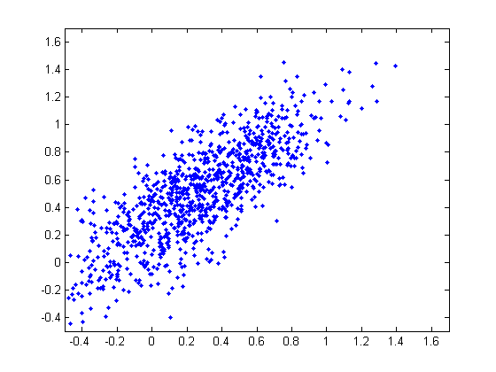
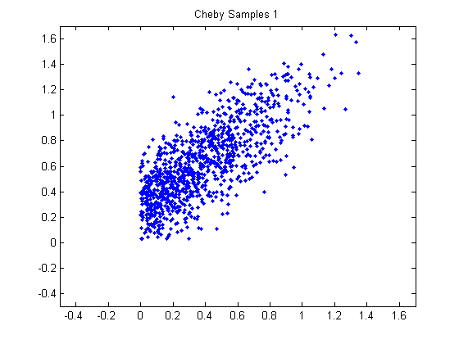
Chebyshev accelerated Gibbs can be adapted to sample under
positivity constraints

Slide 32
One extremely effective sampler for LARGE Gaussians
Use a combination of the ideas presented:
Use the CG sampler to generate samples and estimates of the extreme eigenvalues of G.
Seed these samples and extreme eigenvalues into a Chebyshev accelerated SSOR sampler

Slide 33
Conclusions
Common techniques from numerical linear algebra can be used to sample from Gaussians
Cholesky factorization (precise but expensive)
Any stationary linear solver can be used as a stationary sampler (inexpensive but with geometric convergence)
Polynomial accelerated Samplers
Chebyshev (precise and inexpensive)
CG (precise in a some eigenspaces and inexpensive)

