Slide 1
Center for Biofilm Engineering
A quick summary of:
EPA’s Technical Laboratory Workshop: Antimicrobial Efficacy Test Methods and Activities February 18-19, 2014
Al Parker, CBE
March 6, 2014

Slide 2
Venue:

Slide 3
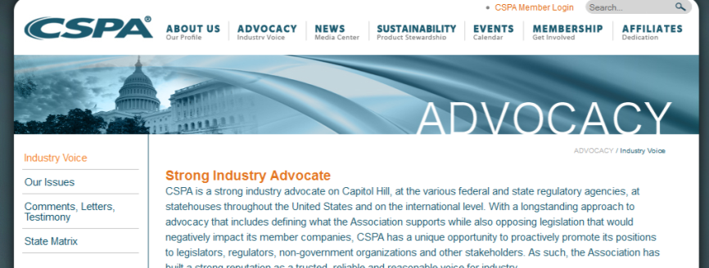
Hosted by EPA & CSPA

Slide 4
Goal: Provide Update on EPA’s test program
Notes:
4

Slide 5
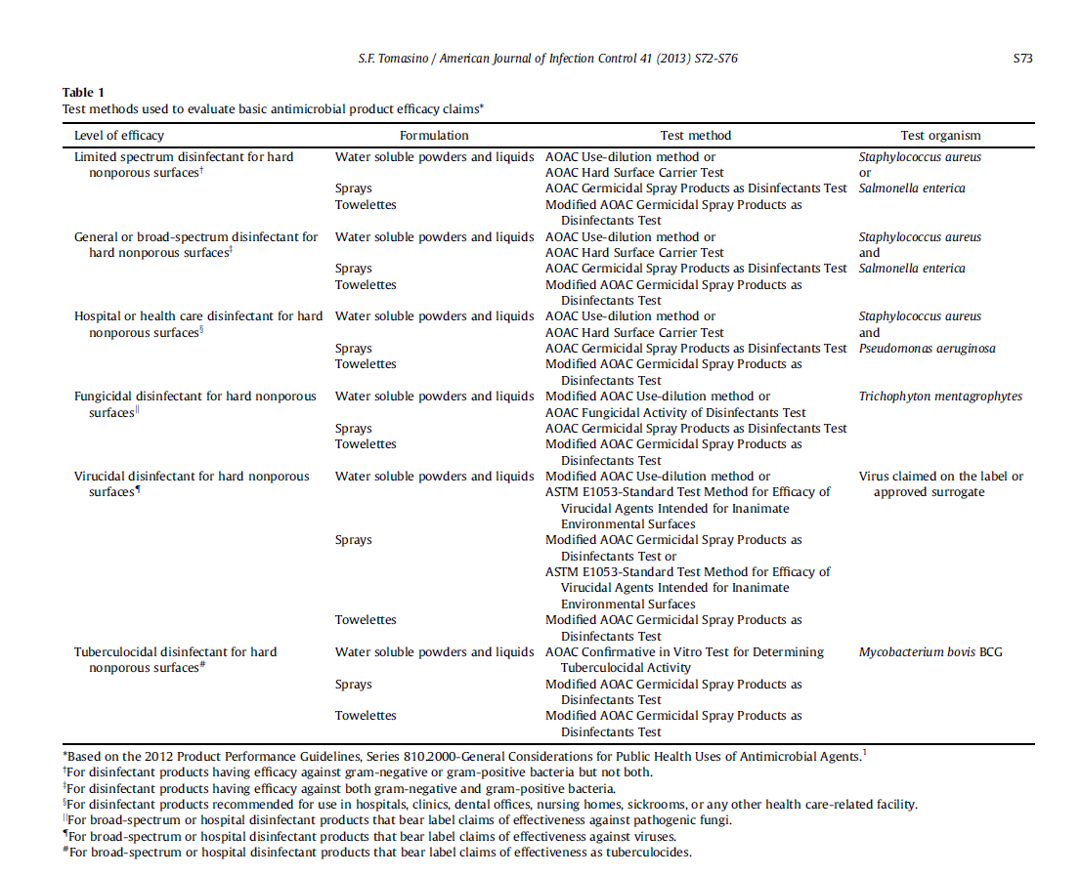
Current EPA methods for product registration
Current EPA
work-horse
is the
semi-quantitative
use-dilution
method
Notes:
5

Slide 6
Current EPA methods for product registration
Current EPA
work-horse
is the
semi-quantitative
use-dilution
method
Notes:
6

Slide 7
New method for EPA registration
Proposed new EPA
work-horse
is the
quantitative
OECD
Notes:
7
From wiki: The Organisation for Economic Co-operation and Development (OECD) (French: Organisation de coopération et de développement économiques, OCDE) is an international economic organisation of 34 countries founded in 1961 to stimulate economic progress and world trade.

Slide 8
New EPA registration processes:
OECD Method
Bactericidal – ongoing efforts
Mycobactericidal – collaborative study results
Virucidal – ongoing efforts and plans for a collaborative study
Fungicidal – future efforts
Other new methods for claims for:
sporicides of C. difficil (AOAC three step method)
antimicrobial towelettes – ASTM Quantitative Petri Plate Method (QPM)
anti-biofilm products – ASTM Single Tube method (STM)

Slide 9
A Biofilm claim for surface disinfectants???!!!!
Proposed biofilm organisms to test:
P. aeruginosa
S. aureus
Notes:
9

Slide 10
A Biofilm claim for surface disinfectants???!!!!
Proposed biofilm test method:
Single Tube Method
Notes:
10

Slide 11
A Biofilm claim for surface disinfectants???!!!!
Proposed testing requirements:
2 orgs
3 tests/org
3-5 reps/test/org
LR > 5 per test
Notes:
11

Slide 12
A Biofilm claim for surface disinfectants???!!!!
Notes:
12

Slide 13
CBE opportunities ahead:
New contract in place with EPA as of February, 2014
Optimize CDC reactor and Single Tube Method for S. aureus
Standardize with ASTM EPA’s proposed changes to CDC and Single Tube Methods
Assist with implementation and statistical analysis of future multi-lab studies of proposed new regulatory methods for:
tuberculocides
C. difficil sporicides
fungicides
virucides
anti-microbial towelettes
Statistically assess performance standards (numbers of replicates and LR requirements) for proposed methods
Notes:
13

