Slide 1
Center for Biofilm Engineering
Importance of
Statistical Design and Analysis
Al Parker
Standardized Biofilm Methods Research Team
Montana State University
July, 2010

Slide 2
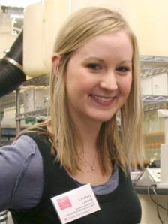
Standardized Biofilm Methods Laboratory
Al Parker
Darla Goeres
Marty Hamilton
Lindsey Lorenz
Diane Walker
Paul Sturman
Kelli Buckingham-Meyer

Slide 3
What is statistical thinking?
Data
Design
Uncertainty assessment
Notes:
Once you have chosen a reactor system relevant to your question of interest, it is time for some statistical thinking.

Slide 4
What is statistical thinking?
Data (pixel intensity in an image?
log(cfu) from viable plate counts?)
Design
- controls
- randomization
- replication (How many coupons? experiments? technicians? Labs?)
Uncertainty and variability assessment
Notes:
As microbiology evolves and we move into quantitative methods, performing experiments with control data is of paramount importance.
Type of reactor. How many coupons per reactor experiment. How many experiments? How many technicians? How many labs?

Slide 5
Why statistical thinking?
Provide convincing results
Anticipate criticism
Increase efficiency
Improve communication
Notes:
The application of statistical thinking leads one to anticipate criticism and make necessary adjustments, thereby improving the method. If good statistical characteristics have been established for a method, product efficacy values based on that method will probably be convincing to others. Statistical evaluation of a laboratory method depends on experiments that entail proper control, replication, and randomization. Statistical techniques can be used to find the smallest set of experiments that will achieve a comprehensive evaluation.

Slide 6
Attributes of a standard method: Seven R’s
Relevance
Reasonableness
Resemblance
Repeatability (intra-laboratory reproducibility)
Ruggedness
Responsiveness
Reproducibility (inter-laboratory)
Notes:
6

Slide 7
Attributes of a standard method: Seven R’s
Relevance
Reasonableness
Resemblance
Repeatability (intra-laboratory reproducibility)
Ruggedness
Responsiveness
Reproducibility (inter-laboratory)
Notes:
7

Slide 8
Resemblance
Independent repeats of the same experiment in the same laboratory produce nearly the same control data, as indicated by a small repeatability standard deviation.
Statistical tool:
nested analysis of variance (ANOVA)

Slide 9
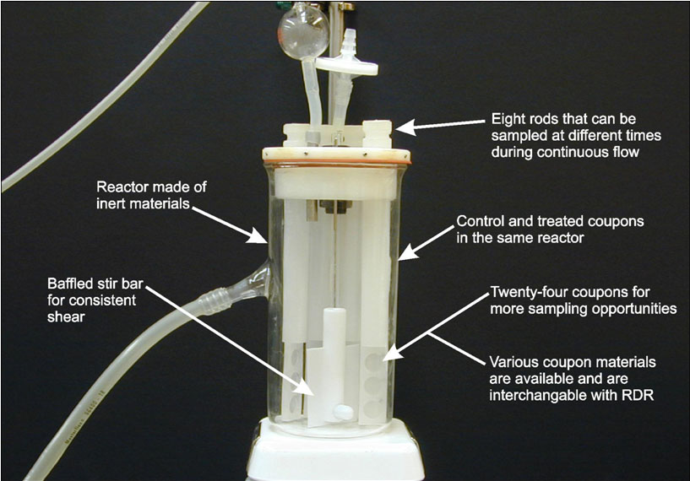
Resemblance Example

Slide 10
Resemblance Example
Data: log₁₀(cfu) from viable plate counts
Coupon Density LD
cfu / cm² log(cfu/cm²)
1 5.5 x 10⁶ 6.74
2 6.6 x 10⁶ 6.82
3 8.7 x 10⁶ 6.94
Mean LD= 6.83
Notes:
Take log transforms! Then calculate all statistics on the log scale.

Slide 11
Resemblance Example
Exp | control LD |  | Mean LD |  |  | SD
1 | 6.73849
1 | 6.82056 |  | 6.83240 |  |  | 0.10036
1 | 6.93816
2 | 6.66276
2 | 6.73957 |  | 6.71440 |  |  | 0.04473
2 | 6.74086
3 | 6.91564
3 | 6.74557 |  | 6.85293 |  |  | 0.09341
3 | 6.89758
Notes:
Take log transforms! Then calculate all statistics on the log scale.

Slide 12
Resemblance from experiment to experiment
Mean LD = 6.77
S_{r} = 0.15
the typical distance between a control coupon LD from an experiment and the true mean LD
log₁₀ (cfu/cm²)
Notes:
Since S_{r} = .15, these data indicate good resemblance of the control data from experiment to experiment.

Slide 13
Resemblance from experiment to experiment
The variance S_{r}² can be partitioned:
69% due to between experiment sources
31% due to within experiment sources
log₁₀ (cfu/cm²)

Slide 14
Formula for the SE of the mean control LD, averaged over experiments
S_{c} = within-experiment variance of control coupon LD
S_{E} = between-experiments variance of control coupon LD
n_{c} = number of control coupons per experiment
m = number of experiments
2
2
S
2
S
2
SE of mean control LD =
c
E
+
n_{c} • m
m
Notes:
SE is the SD of a statistic.

Slide 15
Formula for the SE of the mean control LD, averaged over experiments
S_{c} = 0.31 x (.15)² = 0.006975
S_{E} = 0.69 x (.15)² = 0.015525
n_{c} = 3
m = 3
2
2
.006975
.015525
SE of mean control LD =
+
= 0.0771
3 • 3
3
95% CI for mean control LD = 6.77 ± t₆ x 0.0771
= (6.58, 6.96)
Notes:
df = m*(n – 1) = 3*2 = 6 (see Neter et al. p. 963), agrees with R’s lme does.

Slide 16
Resemblance from technician to technician
Mean LD = 8.42
S_{r} = 0.17
the typical distance between a coupon LD and the true mean LD
log₁₀ (cfu/cm²)

Slide 17
Resemblance from technician to technician
The variance S_{r}² can be partitioned:
39% due to technician sources
43% due to between experiment sources
18% due to within experiment sources
log₁₀ (cfu/cm²)

Slide 18
Repeatability
Independent repeats of the same experiment in the same laboratory produce nearly the same data, as indicated by a small repeatability standard deviation.
Statistical tool: nested ANOVA

Slide 19
Repeatability Example
Data: log reduction (LR)
LR = mean(control LDs) – mean(disinfected LDs)

Slide 20
Repeatability Example
Exp | control LD |  | Mean LD |  |  | SD
1 | 6.73849
1 | 6.82056 |  | 6.83240 |  |  | 0.10036
1 | 6.93816
2 | 6.66276
2 | 6.73957 |  | 6.71440 |  |  | 0.04473
2 | 6.74086
3 | 6.91564
3 | 6.74557 |  | 6.85293 |  |  | 0.09341
3 | 6.89758

Slide 21
Repeatability Example
 | log density |  |  | mean log density
Exp | control | disinfected |  | control | disinfected |  | log reduction
1 | 6.73849 | 3.08115
1 | 6.82056 | 3.29326 |  | 6.83240 | 3.13546 |  | 3.69695
1 | 6.93816 | 3.03196
2 | 6.66276 | 2.92334
2 | 6.73957 | 3.03488 |  | 6.71440 | 3.05656 |  | 3.65784
2 | 6.74086 | 3.21146
3 | 6.91564 | 2.73748
3 | 6.74557 | 2.66018 |  | 6.85293 | 2.70805 |  | 4.14488
3 | 6.89758 | 2.72651
Mean LR = 3.83

Slide 22
Repeatability Example
Mean LR = 3.83
S_{r} = 0.27
the typical distance between a LR for an experiment and the true mean LR
Notes:
LR are more variable than the controls!

Slide 23
Formula for the SE of the mean LR, averaged over experiments
S_{c} = within-experiment variance of control coupon LD
S_{d} = within-experiment variance of disinfected coupon LD
S_{E} = between-experiments variance of LR
n_{c} = number of control coupons
n_{d} = number of disinfected coupons
m = number of experiments
2
2
2
S
2
S
2
S
2
SE of mean LR =
c
d
E
+
+
n_{c} • m
n_{d} • m
m

Slide 24
Formula for the SE of the mean LR, averaged over experiments
S_{c}² = 0.006975
S_{d}² = 0.014045
S_{E}² = 0.066234
n_{c} = 3, n_{d} = 3, m = 3
.006975
.014045
.066234
SE of mean LR =
= 0.156
+
+
3 • 3
3 • 3
3
95% CI for mean LR = 3.83 ± t₂ x 0.156
= (3.16, 4.50)

Slide 25
How many coupons? experiments?
.006975
.014045
.066234
SE of mean LR =
+
+
n_{c} • m
n_{d} • m
m
no. control coupons (n_{c}): | 2 | 3 | 6 | 12
no. disinfected coupons (n_{d}): | 2 | 3 | 6 | 12
no. experiments (m)
1 | 0.277 | 0.271 | 0.264 | 0.261
2 | 0.196 | 0.191 | 0.187 | 0.184
3 | 0.160 | 0.156 | 0.152 | 0.151
4 | 0.138 | 0.135 | 0.132 | 0.130
6 | 0.113 | 0.110 | 0.108 | 0.106
10 | 0.088 | 0.086 | 0.084 | 0.082
100 | 0.028 | 0.027 | 0.026 | 0.026
Notes:
Increasing the number of experiments will decrease the SE of the LR more than increasing the number of coupons! However, it is more expensive to perform more experiments, so the trade-off is cost vs precision of the statistics.

Slide 26
Reproducibility
Repeats of the same experiment run independently by different researchers in different laboratories produce nearly the same result as indicated by a small reproducibility standard deviation. Requires a collaborative (multi-lab) study.
Statistical tool: nested ANOVA

Slide 27
Reproducibility Example
Mean LR = 2.61
S_{R} = 1.07
the typical distance between a LR for an experiment at a lab and the
true mean LR

Slide 28
Reproducibility Example
The variance S_{R}² can be partitioned:
62% due to between lab sources
38% due to between experiment sources

Slide 29
Formula for the SE of the mean LR, averaged over labratories
S_{c}²= within-experiment variance of control coupon LD
S_{d}²= within-experiment variance of disinfected coupon LD
S_{E}²= between-experiments variance of LR
S_{L}²= between-lab variance of LR
n_{c} = number of control coupons
n_{d} = number of disinfected coupons
m = number of experiments
L = number of labs
S
2
S
2
S
2
S
2
SE of mean LR =
c
d
E
L
+
+
+
n_{c}•m•L
n_{d}•m•L
m•L
L

Slide 30
Formula for the SE of the mean LR, averaged over labratories
S_{c}²= 0.007569
S_{d}²= 0.64
S_{E}²= .2171
S_{L}²= 0.707668
n_{c} = 3, n_{d} = 3, m = 3, L = 2
.007569
.64
.2171
.707668
SE of mean LR =
= 0.653
+
+
+
3 • 3 • 2
3 • 3 • 2
3• 2
2
95% CI for mean LR = 2.61 ± t₄ x 0.653
= (0.80, 4.42)
Notes:
df = L*(n – 1) = 2*(3-1)

Slide 31
How many coupons? experiments? labs?
.007569
.64
.2171
.707668
SE of mean LR =
+
+
+
n_{c}•m•L
n_{d}•m•L
m•L
L
no. of labs (L) | 1 | 1 | 1 | 2 | 2 | 2 | 3 | 3 | 3 | 4 | 4 | 4 | 5 | 5 | 5 | 6 | 6 | 6
no. control/dis coupons (n_{c} and n_{d}): | 2 | 3 | 5 | 2 | 3 | 5 | 2 | 3 | 5 | 2 | 3 | 5 | 2 | 3 | 5 | 2 | 3 | 5
no. experiments (m)
1 | 1.117 | 1.068 | 1.027 | 0.790 | 0.755 | 0.726 | 0.645 | 0.617 | 0.593 | 0.559 | 0.534 | 0.513 | 0.500 | 0.478 | 0.459 | 0.456 | 0.436 | 0.419
2 | 0.989 | 0.961 | 0.939 | 0.699 | 0.680 | 0.664 | 0.571 | 0.555 | 0.542 | 0.494 | 0.481 | 0.469 | 0.442 | 0.430 | 0.420 | 0.404 | 0.392 | 0.383
3 | 0.942 | 0.923 | 0.907 | 0.666 | 0.653 | 0.642 | 0.544 | 0.533 | 0.524 | 0.471 | 0.462 | 0.454 | 0.421 | 0.413 | 0.406 | 0.385 | 0.377 | 0.370
4 | 0.918 | 0.903 | 0.891 | 0.649 | 0.639 | 0.630 | 0.530 | 0.522 | 0.515 | 0.459 | 0.452 | 0.446 | 0.411 | 0.404 | 0.399 | 0.375 | 0.369 | 0.364
6 | 0.893 | 0.883 | 0.875 | 0.632 | 0.624 | 0.619 | 0.516 | 0.510 | 0.505 | 0.447 | 0.442 | 0.437 | 0.399 | 0.395 | 0.391 | 0.365 | 0.361 | 0.357
10 | 0.873 | 0.867 | 0.862 | 0.617 | 0.613 | 0.609 | 0.504 | 0.500 | 0.497 | 0.436 | 0.433 | 0.431 | 0.390 | 0.388 | 0.385 | 0.356 | 0.354 | 0.352
100 | 0.844 | 0.844 | 0.843 | 0.597 | 0.597 | 0.596 | 0.488 | 0.487 | 0.487 | 0.422 | 0.422 | 0.422 | 0.378 | 0.377 | 0.377 | 0.345 | 0.344 | 0.344
Notes:
More labs will reduce the variability more than more experiments!

Slide 32
Summary
Even though biofilms are complicated, it is
feasible to develop biofilm methods that meet
the “Seven R” criteria.
Good experiments use control data!
Assess uncertainty by SEs and CIs.
When designing experiments, invest effort in
numbers of experiments versus more coupons
in an experiment).

Slide 33
Any questions?

